Slide 1
Unit 1 Food matters
Integrated skills (II)
谢丹 湖南省醴陵市第一中学

Slide 2
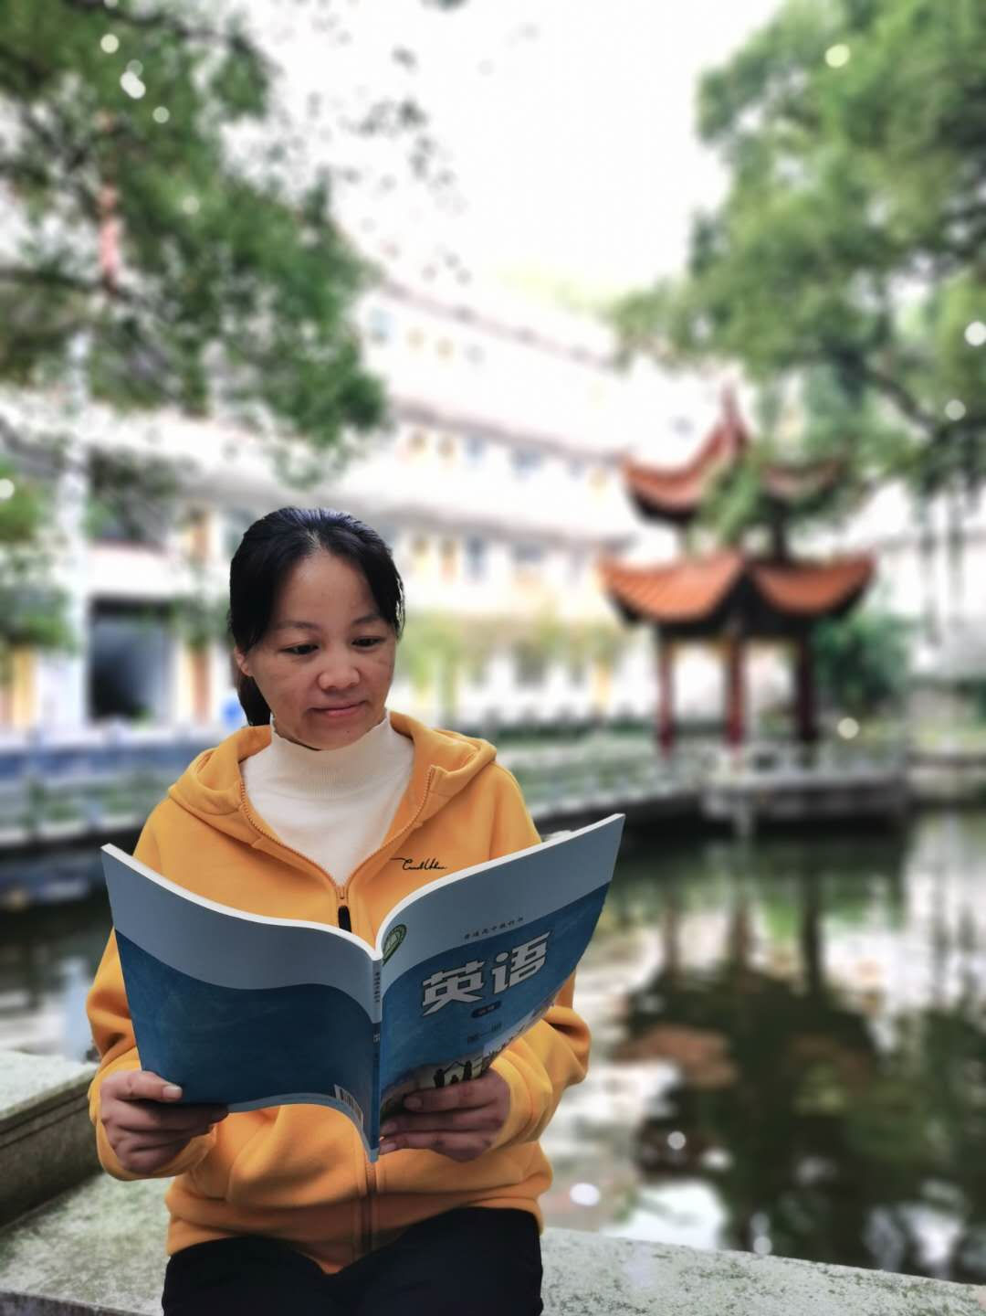
谢丹
中学高级教师
醴陵市高中英语学科带头人
醴陵市高中教学视导专家
2018年株洲市高中英语教学比武一等奖获得者

Slide 3
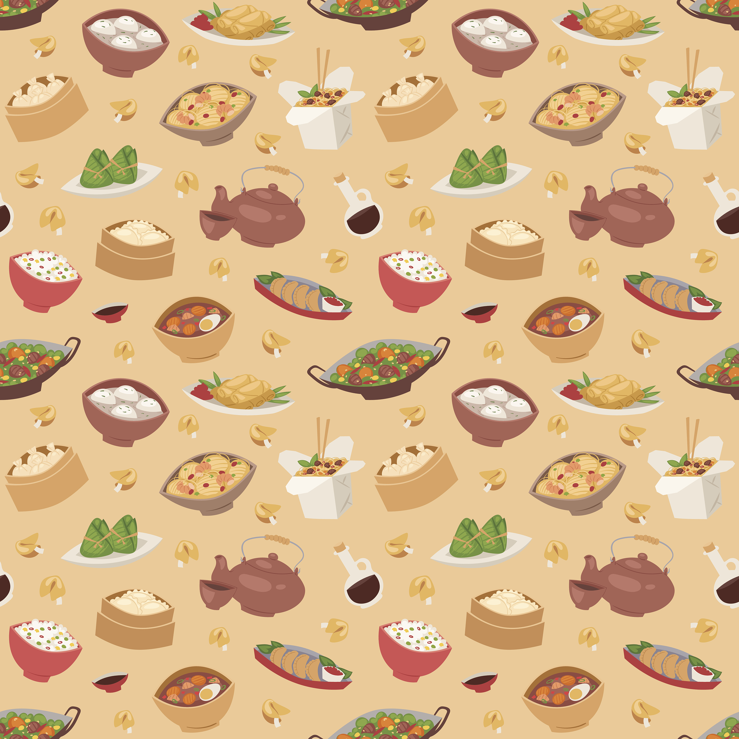
My favorite food

Slide 4
Step 1 Lead-in

Slide 5
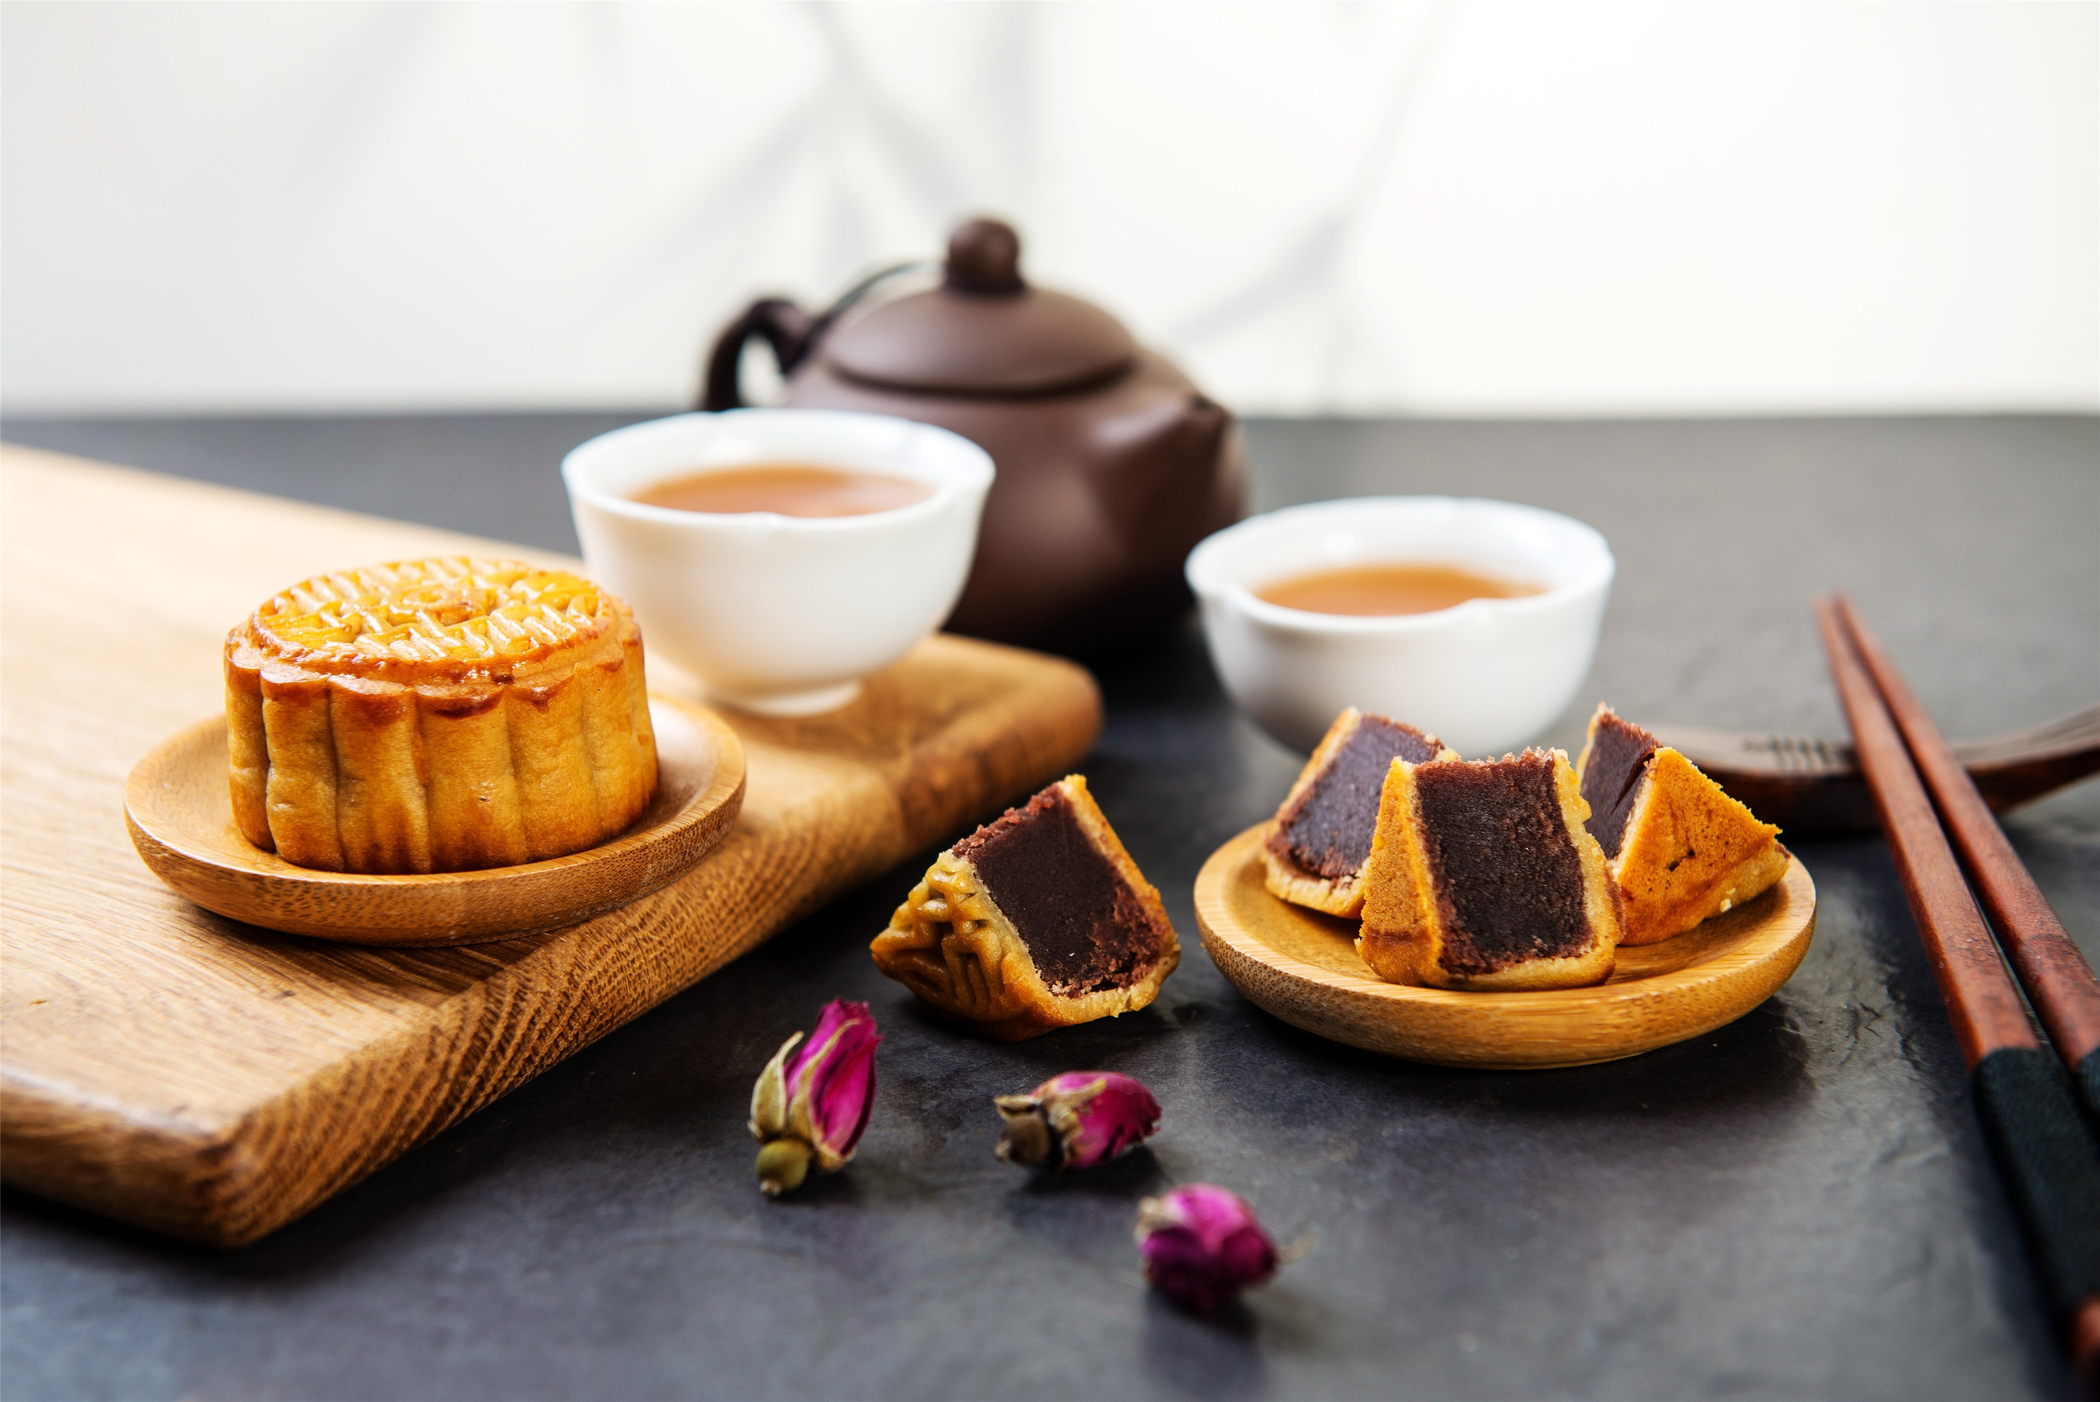
Mooncake

Slide 6
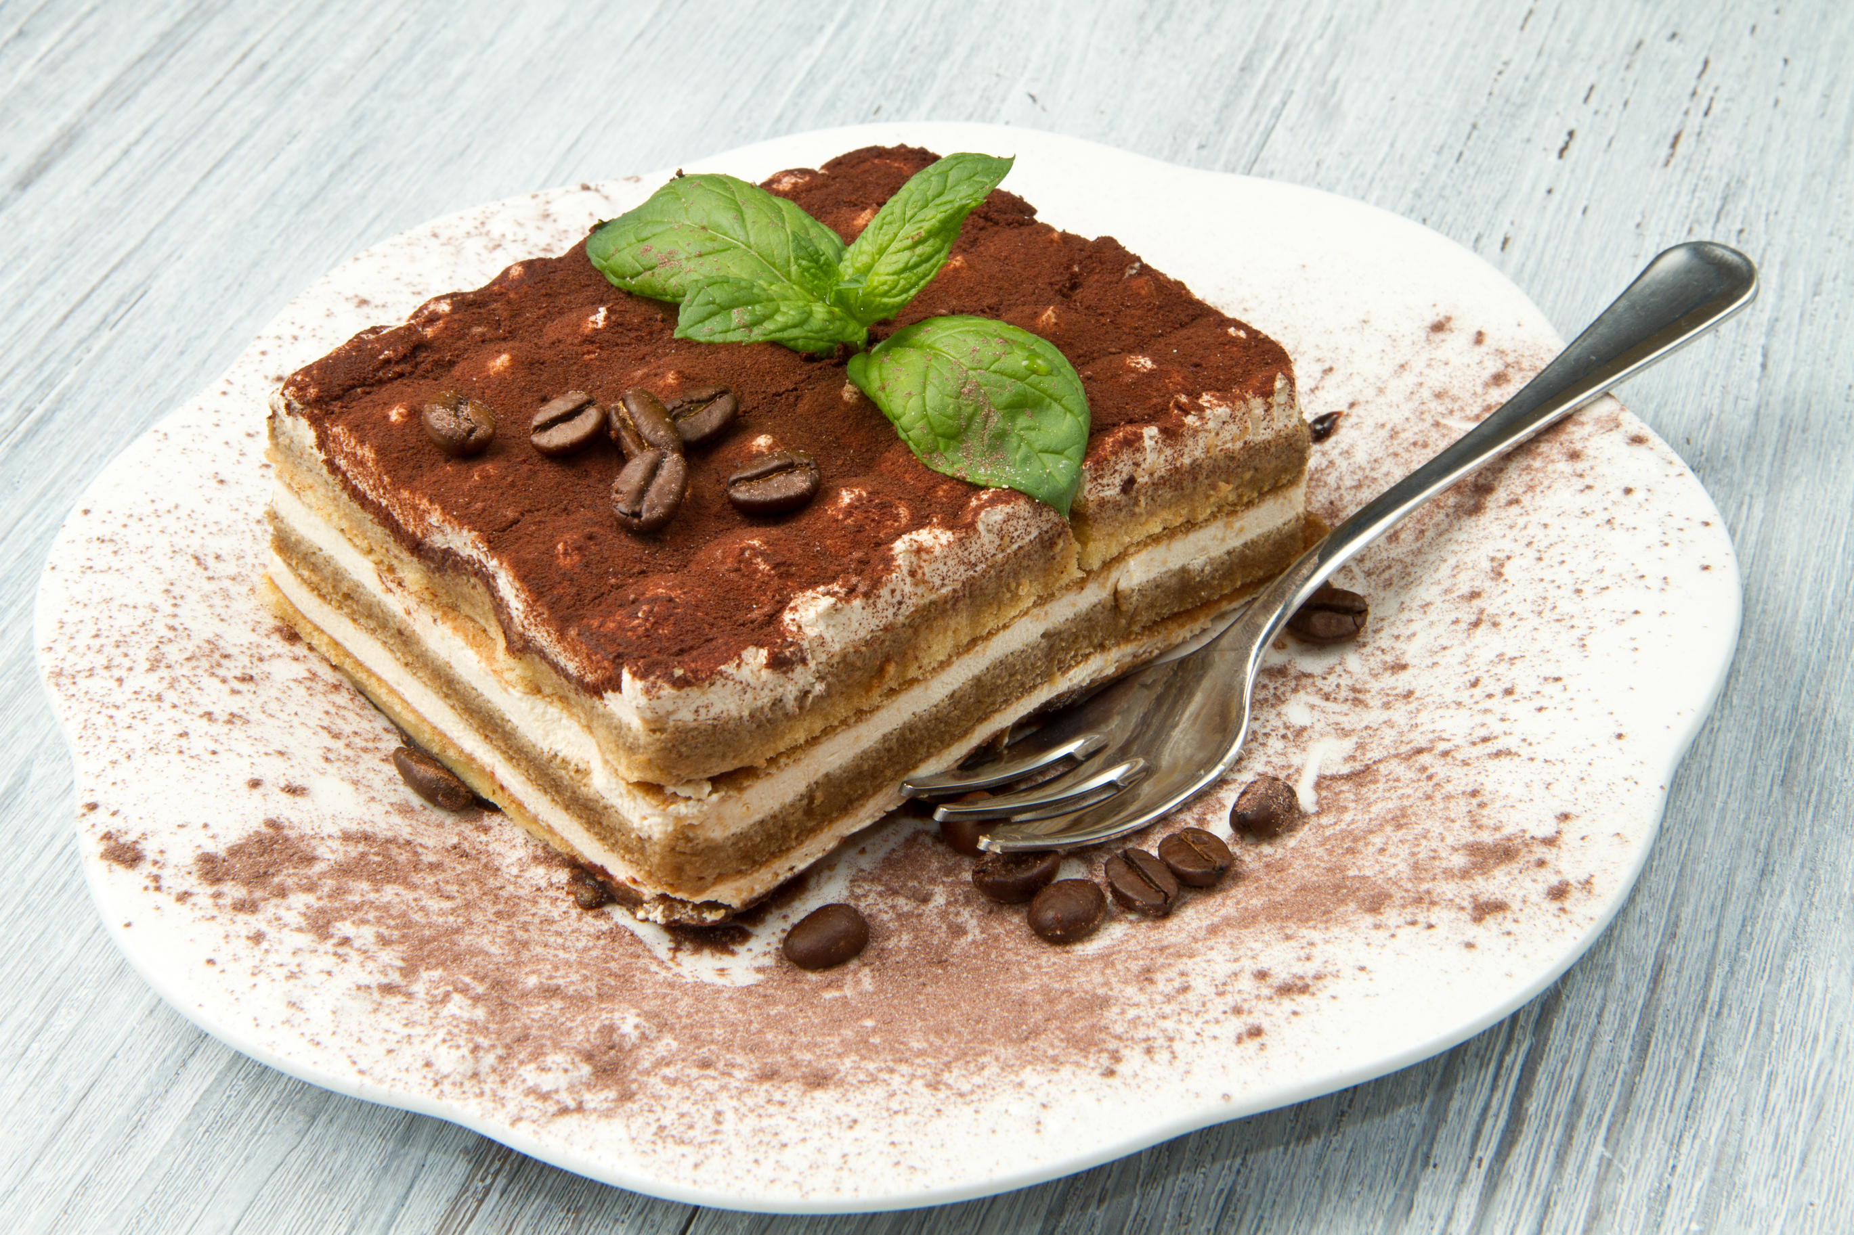
Tiramisu

Slide 7
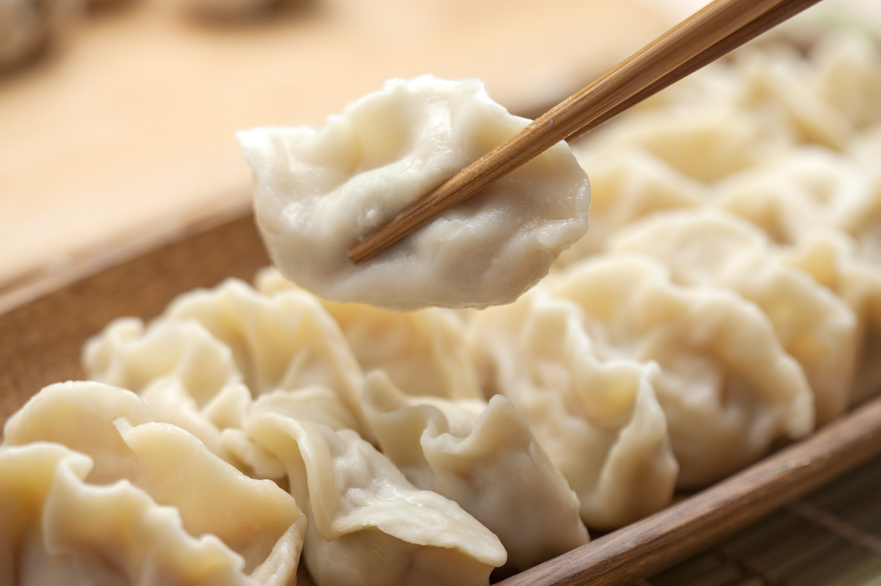
Dumpling

Slide 8
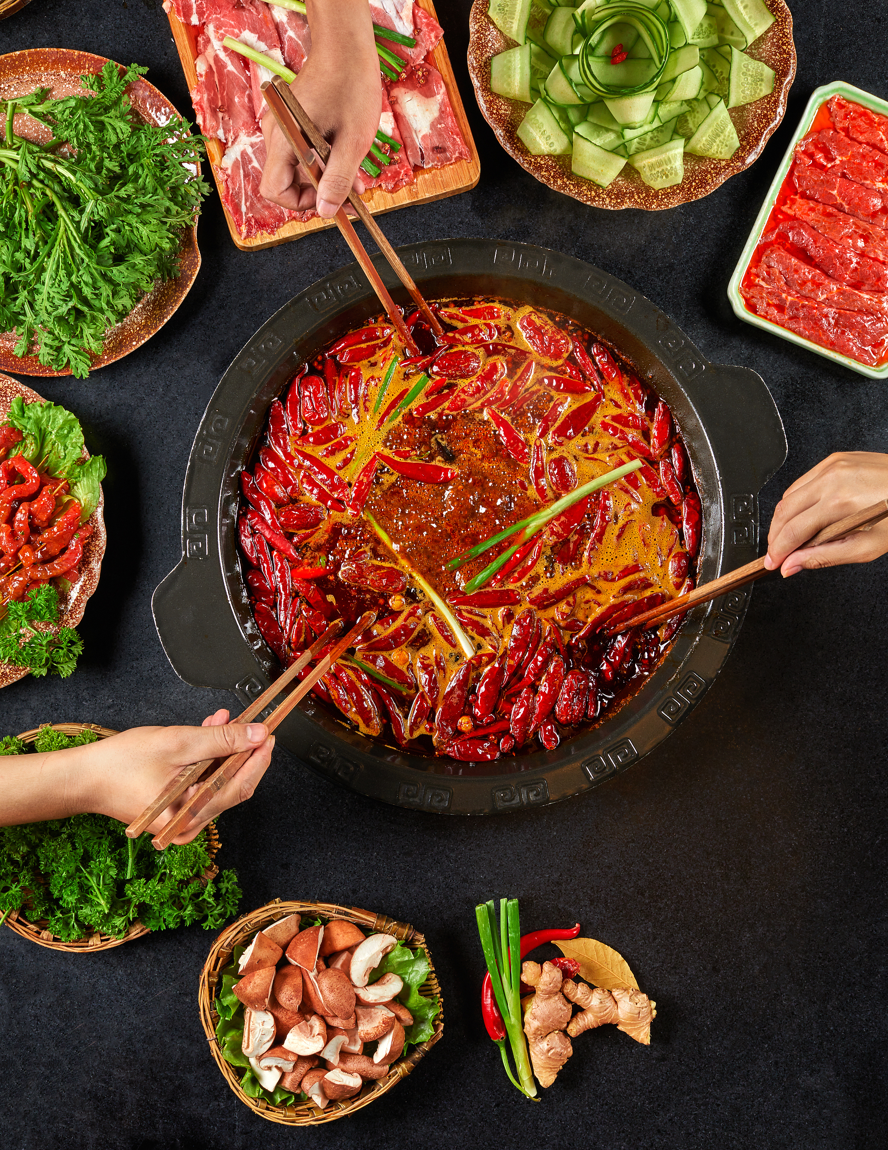
Hot pot

Slide 9
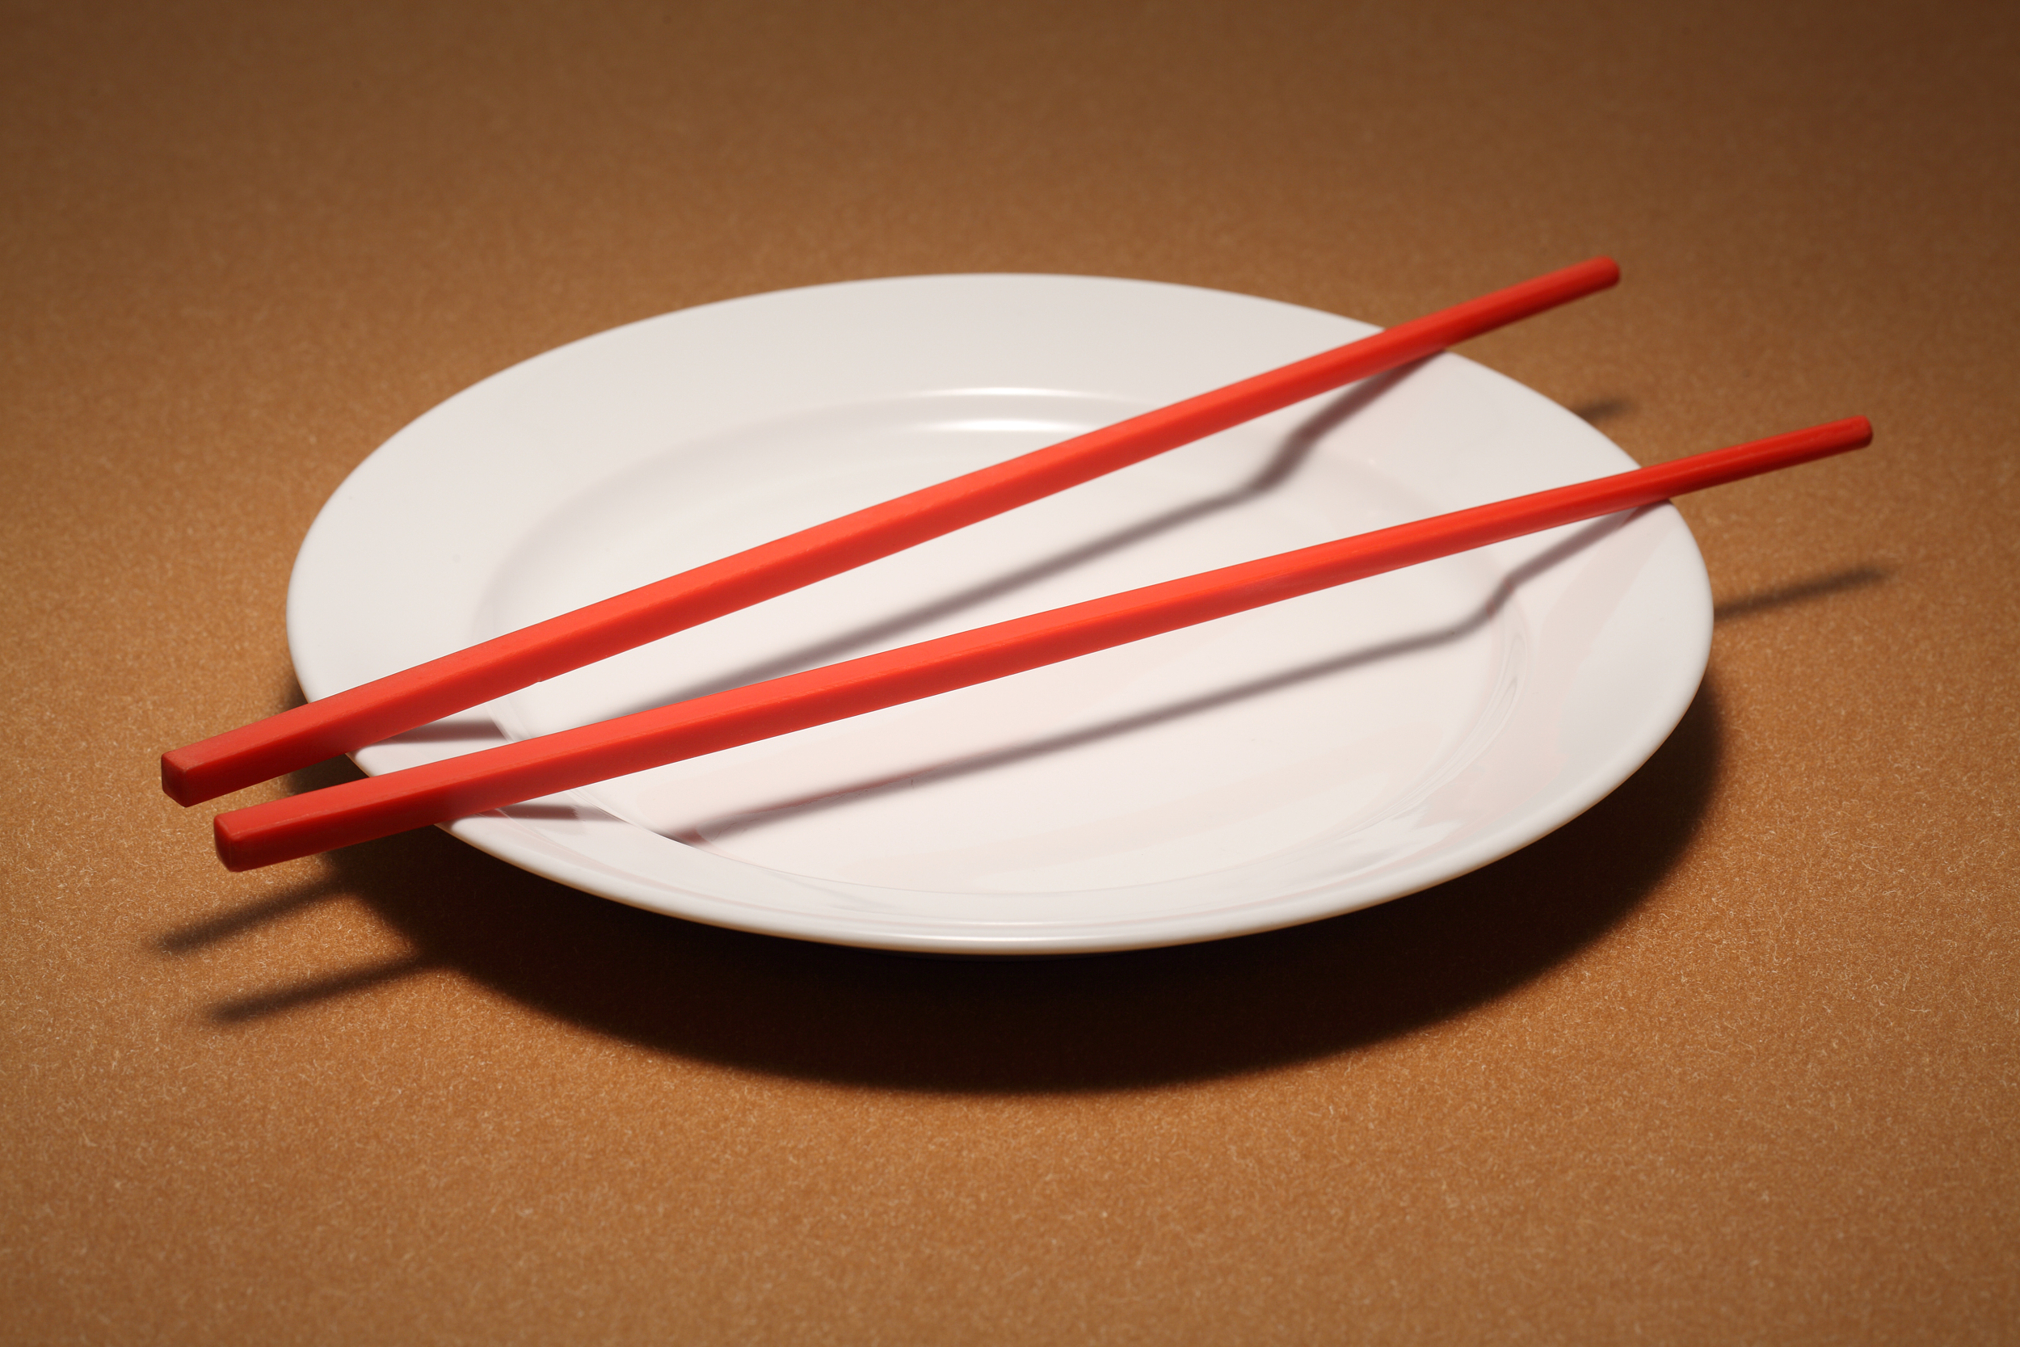
What’s your favorite food?
Why do you like it?

Slide 10
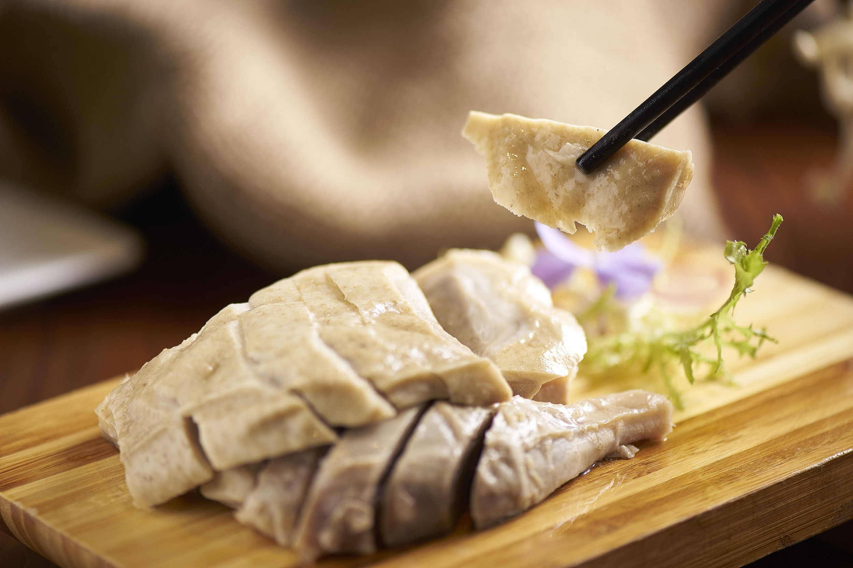
Nanjing salted duck

Slide 11
Step 2
Talking in pairs

Slide 12
Talking about your favorite food
A:What is your favorite food?
B: My favorite food is .../... is one of my personal favorites.
A: Why do you like it? (How it looks, smells, tastes and feels in your mouth, how you associate it with a particular experience, etc.)
B: It looks/smells/tastes/feels ... (smelly, bitter, sweet, salty, juicy,
creamy, silky, smooth, soft, crisp ...)
It reminds me of the days when ...
How can I forget such a tasty dish?
A: Do you know how to cook it?
B: Here are the steps: First, ... Second, ...
A: Is there any interesting stories behind the food?
B: It is said that .../A story goes that ...

Slide 13
Step 3
Presentation

Slide 14
Step 4
Writing an article

Slide 15
Writing an article about your favorite food
Part D
Writing
Part A
Listening
Part C
Speaking
Part B
Reading

Slide 16
Writing an article about your favorite food
Learning about the text type
Learning about the structure
Learning about the language
Planning

Slide 17
Writing an article about your favorite food
The text type
a piece of descriptive writing
to create a vivid picture in readers’ minds
through plenty of sensory details
Planning

Slide 18
Writing an article about your favorite food
The structure
What is your favourite food?
The characteristics
of the food
Your experiences
of tasting it
Planning

Slide 19
Writing an article about your favorite food
The language
vivid
adjectives
smelly, bitter, sweet, salty, juicy, creamy, silky, smooth, soft, crisp ...
Planning

Slide 20
Writing

Slide 21
Punctuation
Spelling
Grammar
aspects
Choice of words
Style (formal/informal)
Checking
Structure

Slide 22
Work in pairs
Self-review
Peer review
Do you use adjectives to describe the food? Is your description vivid enough?
What changes can you make to improve your writing?
Does your partner think there are enough sensory details in you writing?
Which part does your partner find most interesting?

Slide 23
Homework
Polish up your writing.

