Slide 1
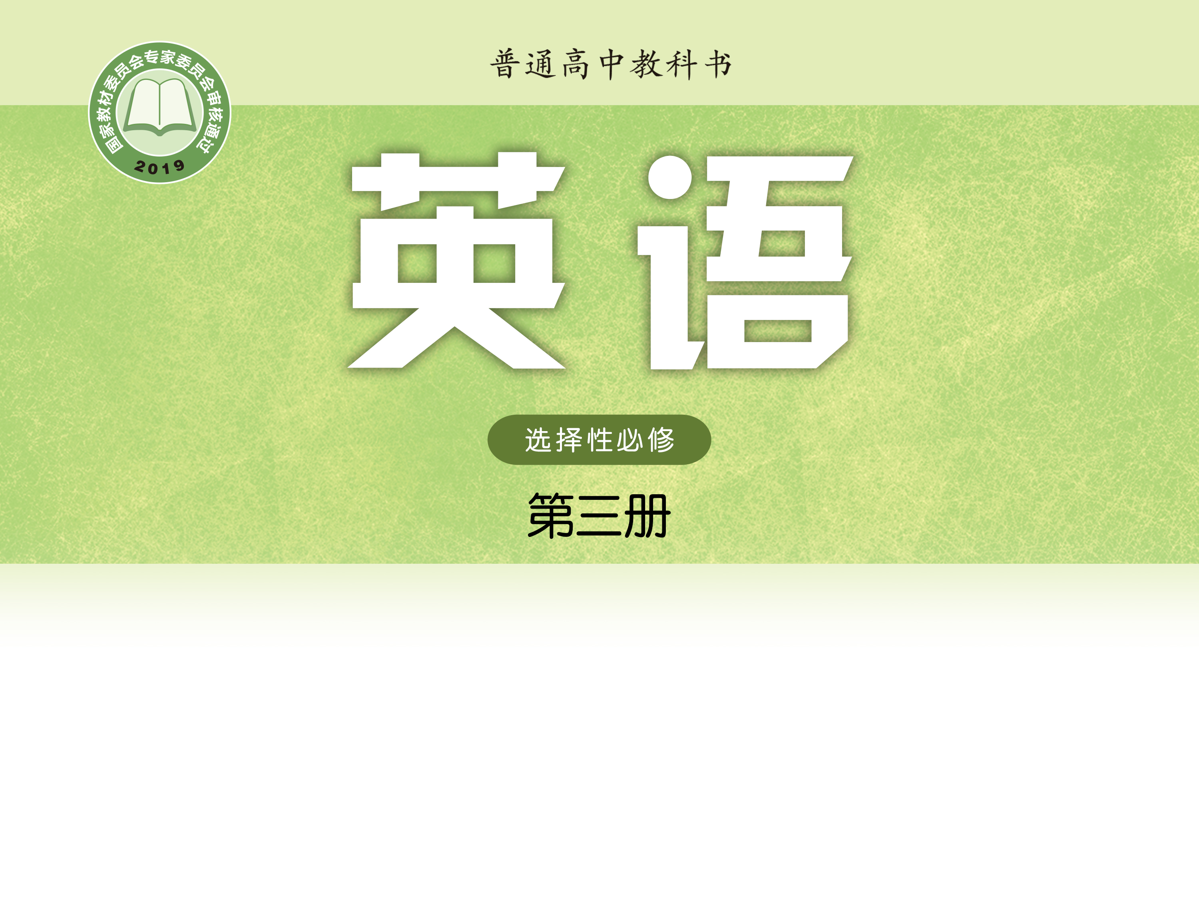
Unit 1 Wish you were here
Grammar and usage
谢丹 湖南省醴陵市第一中学

Slide 2
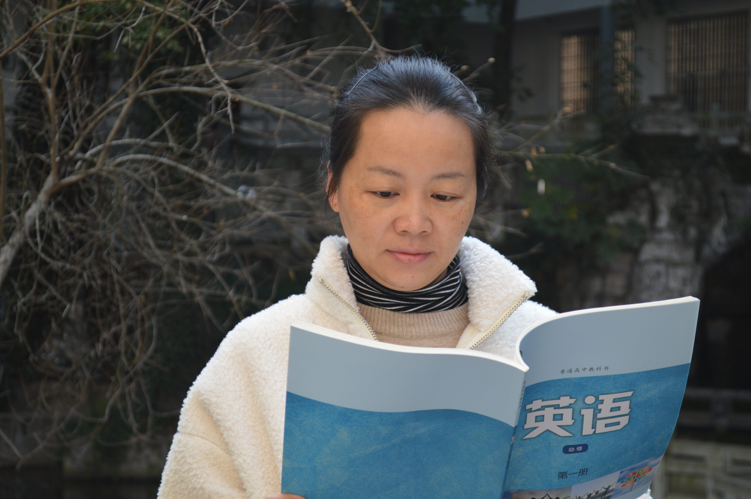
谢丹
中学高级教师
醴陵市高中英语学科带头人

Slide 3
Comparing two sentences
1) In the ten provinces and three territories which make up Canada, there is a great diversity in geography.
a restrictive relative clause
2) To the east of the Pacific coast rise the grand Rocky Mountains which are home to high peaks and deep valleys carved by ice and water.
,
a non-restrictive relative clause

Slide 4
Exploring the rules
These industries, in turn, give jobs to the local population, whose welfare depends on tourism.
The prices of tourist essentials such as transport, accommodation and food usually increase too, which brings even more wealth to the surrounding community.
More nature-centred tourist attractions, where man and nature live in harmony, can be greatly impacted or even destroyed by the flood of tourists.
As resources are used more rapidly than they can be sustained, wildlife habitats are likely to suffer, which could endanger the local plants and animals.
Local festivals and customs, which may have deep meaning in a particular culture, can simply become entertainment for tourists.

Slide 5
Working out the rules
Rule 1:
We often use a non-restrictive relative clause to add _______ information to a noun, pronoun or noun phrase in the main clause or the main clause.
A _________ is usually used to separate the adding clause and the main clause.
extra
comma
This is the house which I bought last year.
2) This house, which I bought last year,
has got a lovely garden.
这就是我去年买的房子。
这个房子是我去年买的，它有一个漂亮的花园。

Slide 6
Exploring the rules
These industries, in turn, give jobs to the local population, whose welfare depends on tourism.
The prices of tourist essentials such as transport, accommodation and food usually increase too, which brings even more wealth to the surrounding community.
More nature-centred tourist attractions, where man and nature live in harmony, can be greatly impacted or even destroyed by the flood of tourists.
As resources are used more rapidly than they can be sustained, wildlife habitats are likely to suffer, which could endanger the local plants and animals.
Local festivals and customs, which may have deep meaning in a particular culture, can simply become entertainment for tourists.

Slide 7
Working out the rules
Rule 2:
We usually introduce a non-restrictive relative clause with a relative pronoun like who, whom, which and whose or a relative adverb like when and where. The relative pronoun and adverb ________ (can /cannot) be left out in a non-restrictive relative clause.
cannot
which
1) I live in Nanjing, ________is a big city.
2) I like my English teacher, _____ speaks good English.
3) I visit my grandparents at the weekend, _______ I do
not go to school.
who
when

Slide 8
Working out the rules
Many people, some of ______ are not overweight, are going on a diet.
I have been to many big cities, all of _______ have left a deep impression on me.
I have invited more than one hundred friends to the party, ______________ (他们中的大部分) are from abroad.
I earn only 1,000 dollars a month, _____________ (其中一半) is spent on my car.
whom
which
most of whom
half of which
Rule 3: We can put some/half/many/most/all of before relative pronouns ______ and ______.
whom
which

Slide 9
Exploring the rules
2) The prices of tourist essentials such as transport, accommodation and food usually increase too, which brings even more wealth to the surrounding community.
4）As resources are used more rapidly than they can be sustained, wildlife habitats are likely to suffer, which could endanger the local plants and animals.

Slide 10
Working out the rules
Rule 4: We can use _________ (which/who/where) in a non-restrictive relative clause to refer to the main clause as a whole.
which
He missed the show, which was a pity.
John told me he would join the Poetry Club, _______ surprised me greatly.
The boy was away from home for a week, __________________________________
(这使他父母很担心).
4) The fire lasted for a whole night, ____________________________ (这造成了极大的破坏).
which
which worried his parents very much
which caused great damage

Slide 11
Working out the rules
____ is known to all, the Moon travels around the Earth.
The book is very interesting, ____ (正如) most readers say.
As
as
Rule 5: We can use ____ in a non-restrictive relative clause to refer to the main clause as a whole and the non-restrictive relative clause can be placed before, among or after the main clause.
as

Slide 12
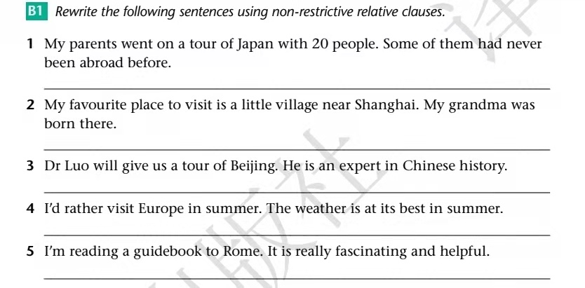
Applying the rules

Slide 13
Applying the rules
My parents went on a tour of Japan with 20 people, some of whom had never been abroad before.
My favorite place to visit is a little village near Shanghai, where my grandma was born.
Dr Luo, who is an expert in Chinese history, will give us a tour of Beijing.
I’d rather visit Europe in summer, when the weather is at its best.
I’m reading a guidebook to Rome, which is really fascinating and helpful.

Slide 14
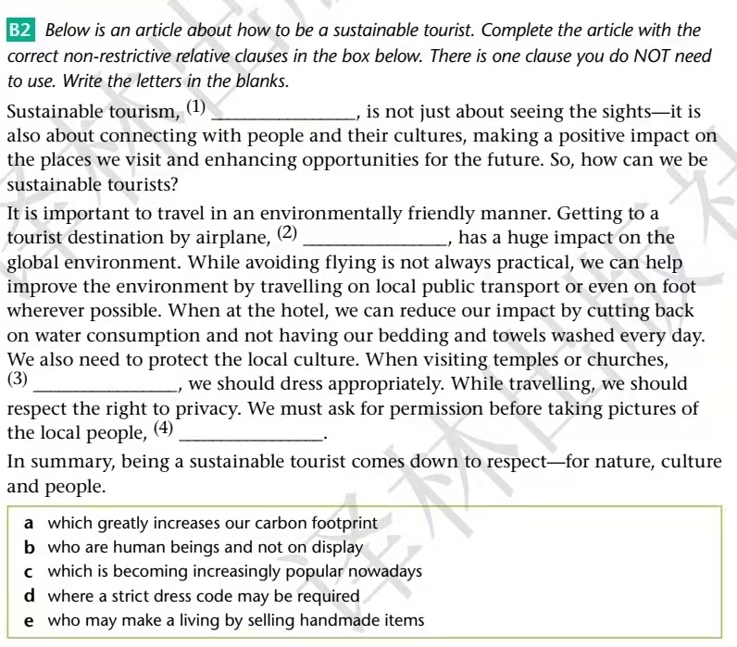
Applying the rules
c
a
d
b

Slide 15
Applying the rules
B3 In pairs, discuss more ways to be a sustainable tourist, using non-restrictive relative clauses.
Example
When you travel, never buy wildlife products, which are made from animal skins or other animal parts.

Slide 16
Ways to be a sustainable tourist
When you travel, you’d better buy souvenirs from the local people, who may make a living by selling handmade items.
When you travel, say no to plastic products, which reduces your carbon footprint.
When you travel, help the local children in the right way in some developing countries, where your kind giving often has unintended consequences.

Slide 17
Homework
Polish your sentences after class and exchange your sentences with other classmates.

