Slide 1

Unit 3 Getting along with others
Welcome to the unit & Reading (I)
钱慧 江苏省如东高级中学

Slide 2


钱慧
2019年江苏省青年教师基本功大赛一等奖获得者
2018年南通市优质课评比一等奖获得者
南通市教坛新秀
如东县骨干教师
如东县优秀青年教师

Slide 3

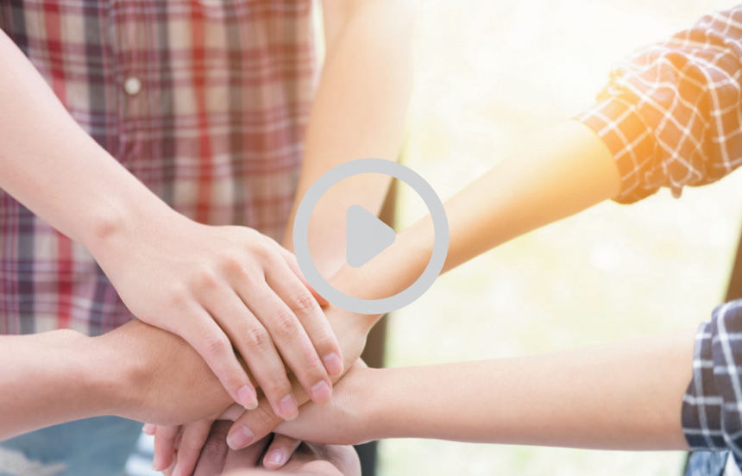
Henry’s problem:
_______________________
Jane’s problem:
_______________________
Bill’s problem:
_______________________

Slide 4
What advice can you give these teenagers?
Have you ever fallen out with your best friend? If you do, share your experience.

Slide 5
problem
What’s the facing Amy?
Her best friend, Jenny, lied to her and broke her heart.

Slide 6
Amy’s problem
Advice given
Saturday morning:
Amy’s friend said she was ill and might not be able to make it to the cinema.
Cindy:
⁽³⁾ __________________
_____________________
_____________________
Saturday afternoon:
⁽¹⁾ __________________
_____________________
David:
⁽⁴⁾ __________________
_____________________
_____________________
Monday:
⁽²⁾ __________________
_____________________

Slide 7
Amy’s problem
Advice given
u
Saturday morning:
Amy’s friend said she was ill and might not be able to make to it to the cinema.
Cindy:
⁽³⁾ ___________________________
______________________________
Save the friendship because eight years is a long time.
v
Saturday afternoon:
⁽¹⁾ _________________
_____________________
_____________________
Amy’s friend was out having fun with someone else.
David:
⁽⁴⁾ ___________________________
______________________________
Rethink this friendship and if necessary, move on.
w
Monday:
⁽²⁾ __________________
____________________
Amy received a horrible surprise.

Slide 8
?
  1. How did Amy view her friend before?
  2. What did Amy and her friend plan to do last Saturday afternoon?
  3. How did Amy learn that her friend went to a café?
  4. What does Cindy mean by “her behaviour” in line 24?
  5. In what case is it time to rethink a friendship, according to David?

Slide 9



Further thinking
It’s time to rethink the relationship.
This friendship is worth saving.
Similarities
and
differences
Have a talk with her friend.
Whose advice do you prefer?
What advice can you offer Amy?

Slide 10
Understanding the language
Be polite and considerate.
  I’m so sorry! But this friendship is worth saving …
  I definitely understand how you feel.
  I’m sure you can solve this problem together.
  It’s sad to move on, but you have to accept that …
Be selective and persuasive.
  Perhaps ..., or maybe ... In any case ...
  I also had a friend who ...
  (Support your ideas with personal experiences or stories if possible.)

Slide 11
Understanding the changes of emotions
How did Amy feel when she discovered that her best friend lied to her?
shocked
I received a horrible surprise.
How stupid I was!
I was so angry that I avoided her during school all day, and I still don’t feel like responding to any of her online messages.
angry
The stress of this situation is killing me.
I’m at a loss what to do next.
confused

Slide 12

Learning a lesson
①
Friendship will no longer last if there is no _____.
trust
Don’t ever lie.

Slide 13
Learning a lesson
②
Cold war
____ ___won’t help to fix a broken friendship.
Have a face-to-face talk
Be open-minded.
Be frank.
Be a good listener.

Slide 14
Learning a lesson
③
Friends come and go in life. Not every friend deserves to be _______________.
cherished/treasured
Let go of the past and move on.

Slide 15

Planning
Host
Help seeker
Friendship
Forum Exchange
Y
Experts
Decide on the problem: I fall out with my best friend because ...

Slide 16
Preparing
Write down your ideas and organize them in a logical way: (Apply as many words and expressions learnt in class as possible.)
________________________________________________________________________________________________________________________________________________________________________________________________________________________________________________________________________________________________________________________________________________________________________
Friendship Forum Exchange

Slide 17
Presenting
P
The host may begin and end his/her talk as follows:
Good afternoon, welcome back to our program—the Friendship Forum Exchange ... Let’s connect the first help seeker ... What advice can you give to him/her? ... May you get over the problem soon. Goodbye!
So much for today’s program. Thank you for being with us. See you next time.

Slide 18

Presenting
Use proper language, show sympathy and respect.
Present the problem or advice in a logical way.
State your ideas with emotions.

Slide 19

Homework
Write a reply to Amy’s post, offering your advice and helping her out of trouble.
_______________________________________________________________________________________________________________________________________________________________________________________

Slide 20


